Slide 1
In-class Exercise 15 - Representation
Dhiren Gupta
-800902466

Slide 2
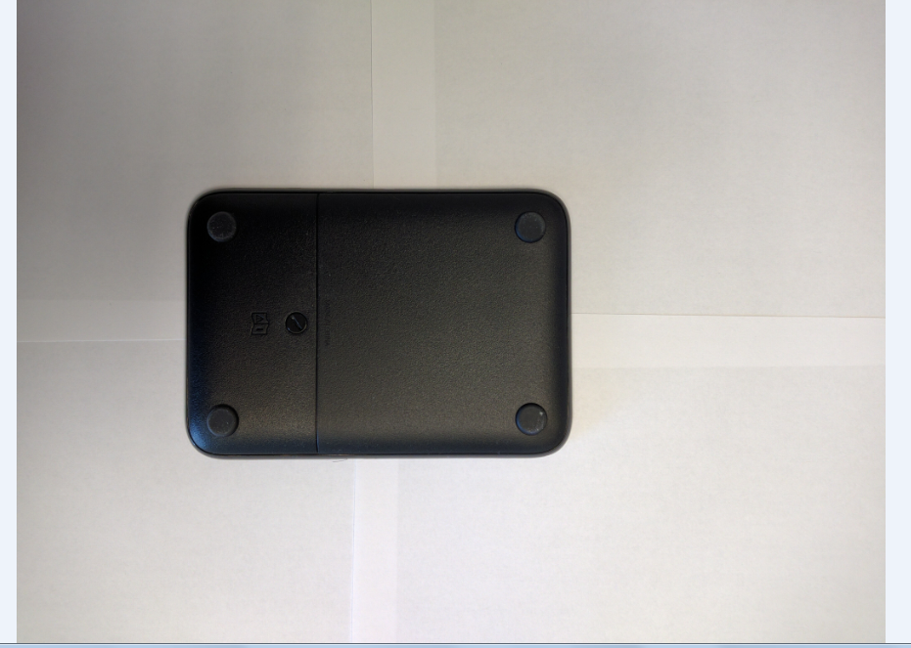

Input Image 1 vs Largest region

Slide 3
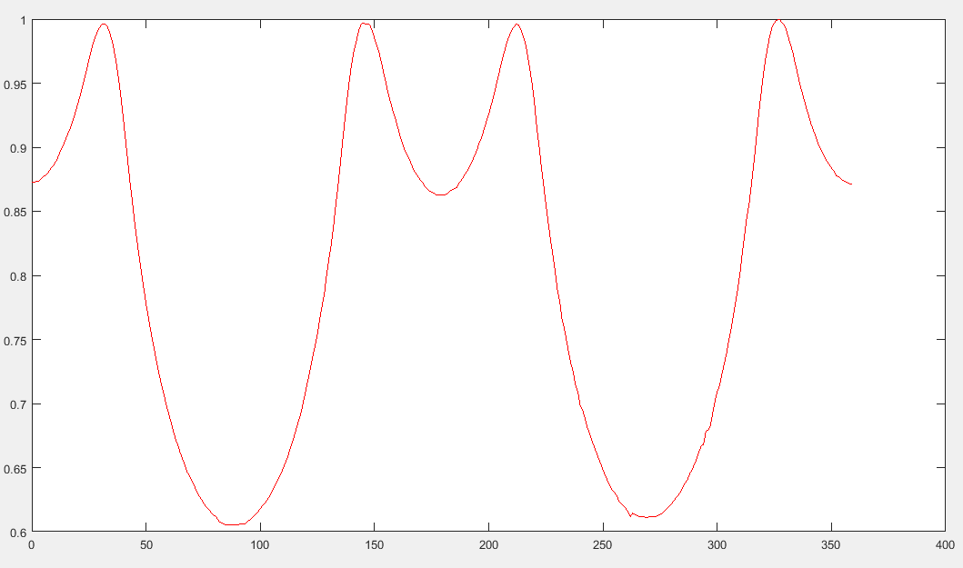
Centroid distance function-1

Slide 4
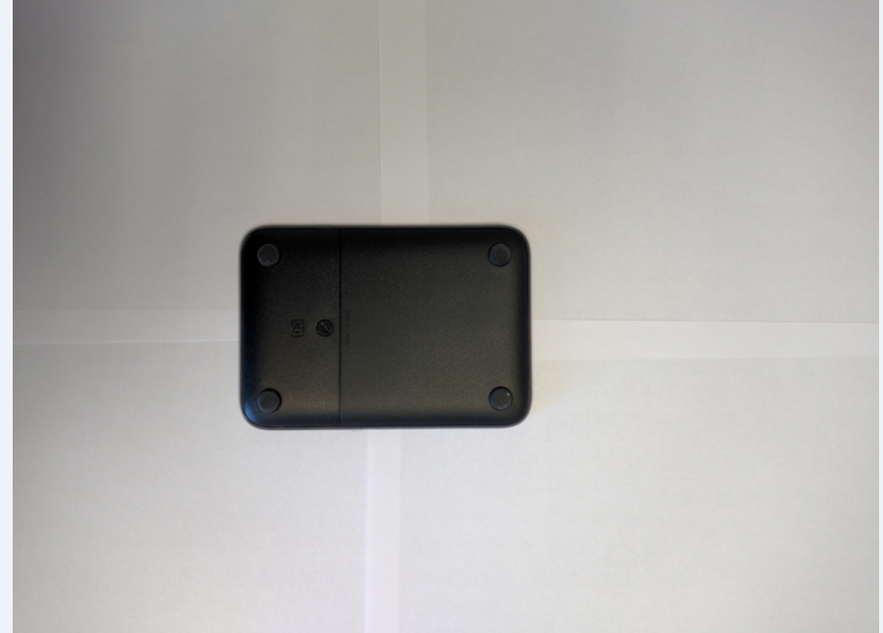

Input Image 2 vs Largest region

Slide 5
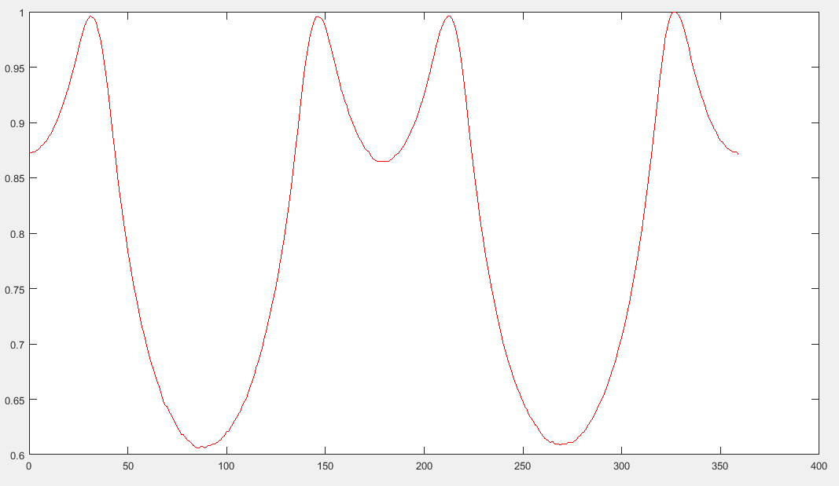
Centroid distance function-2

Slide 6
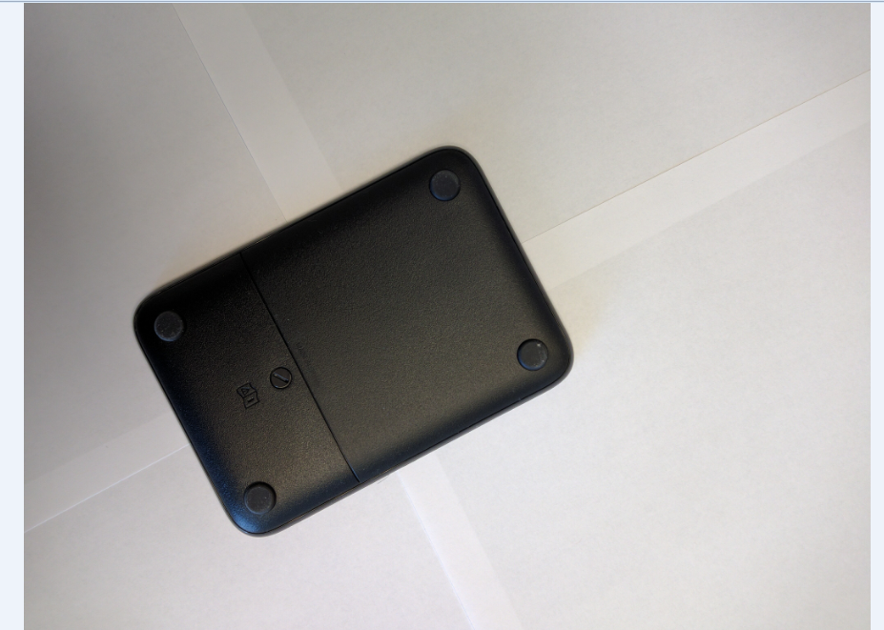

Input Image 3 vs Largest region

Slide 7
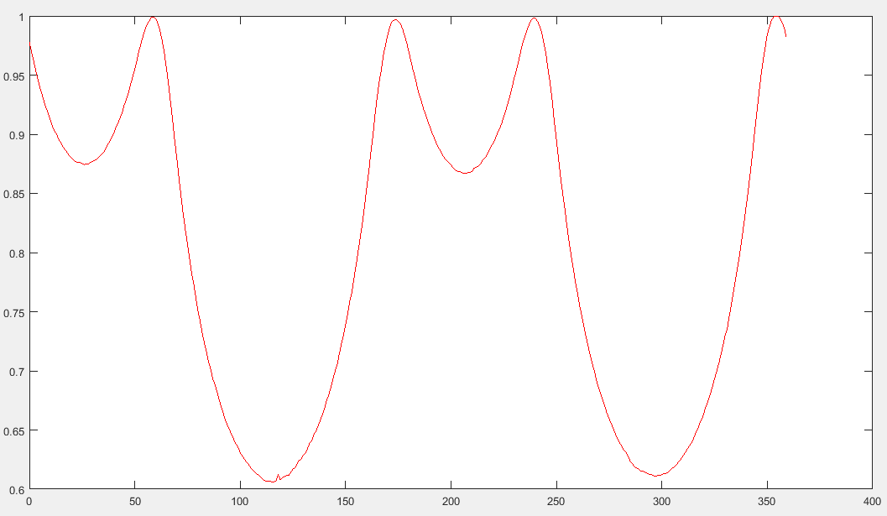
Centroid distance function-3

Slide 8
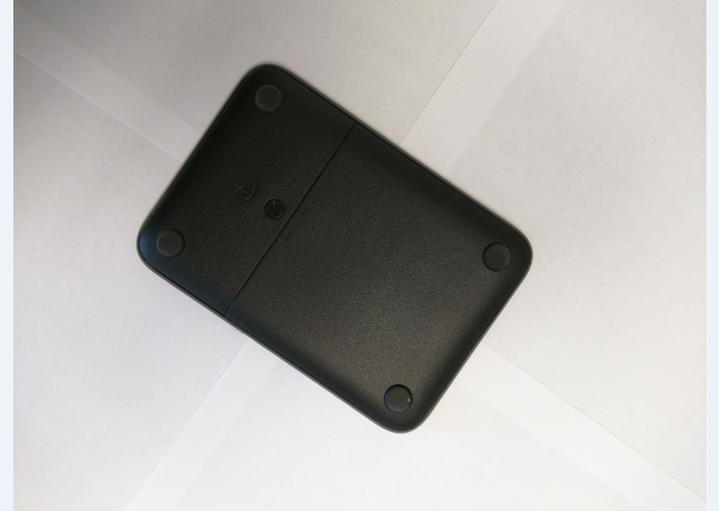

Input Image 4 vs Largest region

Slide 9
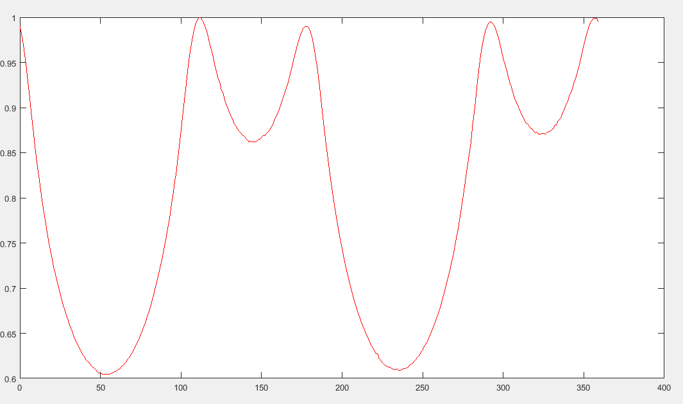
Centroid distance function 4

Slide 10
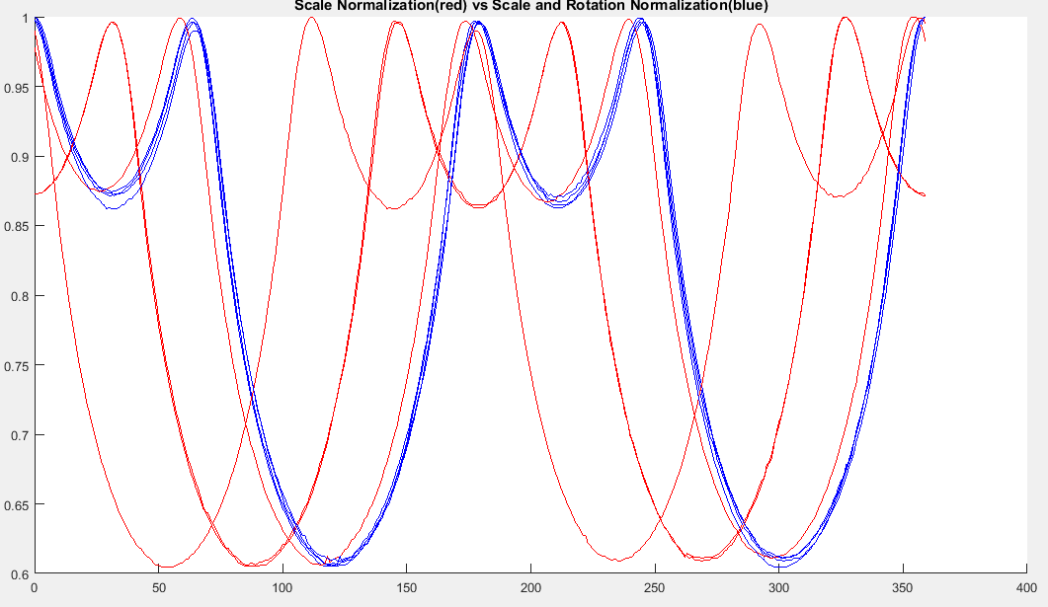
Comparision

Slide 11
Thank You

